Slide 1



Retail Sales Analysis - Pet Circle

Slide 2
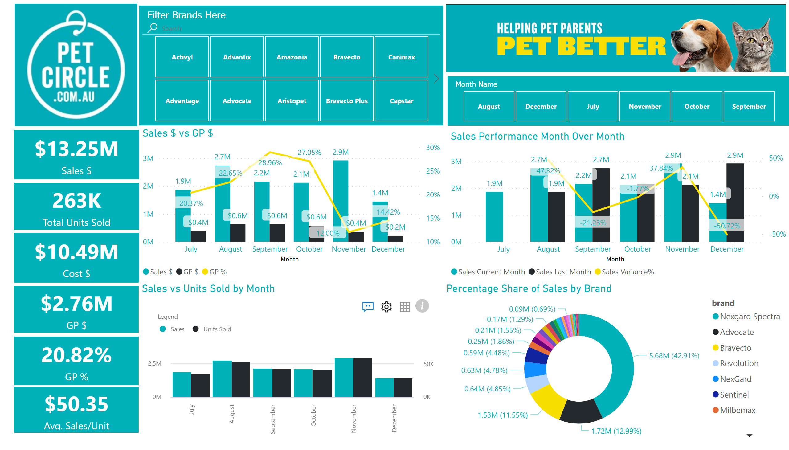
Overall Trend
Notes:
image
No alt text provided
image
No alt text provided
card
No alt text provided
card
No alt text provided
card
No alt text provided
card
No alt text provided
card
No alt text provided
card
No alt text provided
slicer
No alt text provided
slicer
No alt text provided
Sales $ vs GP $
No alt text provided
Sales vs Units Sold by Month
No alt text provided
Sales Performance Month Over Month
No alt text provided
Percentage Share of Sales by Brand
No alt text provided

Slide 3
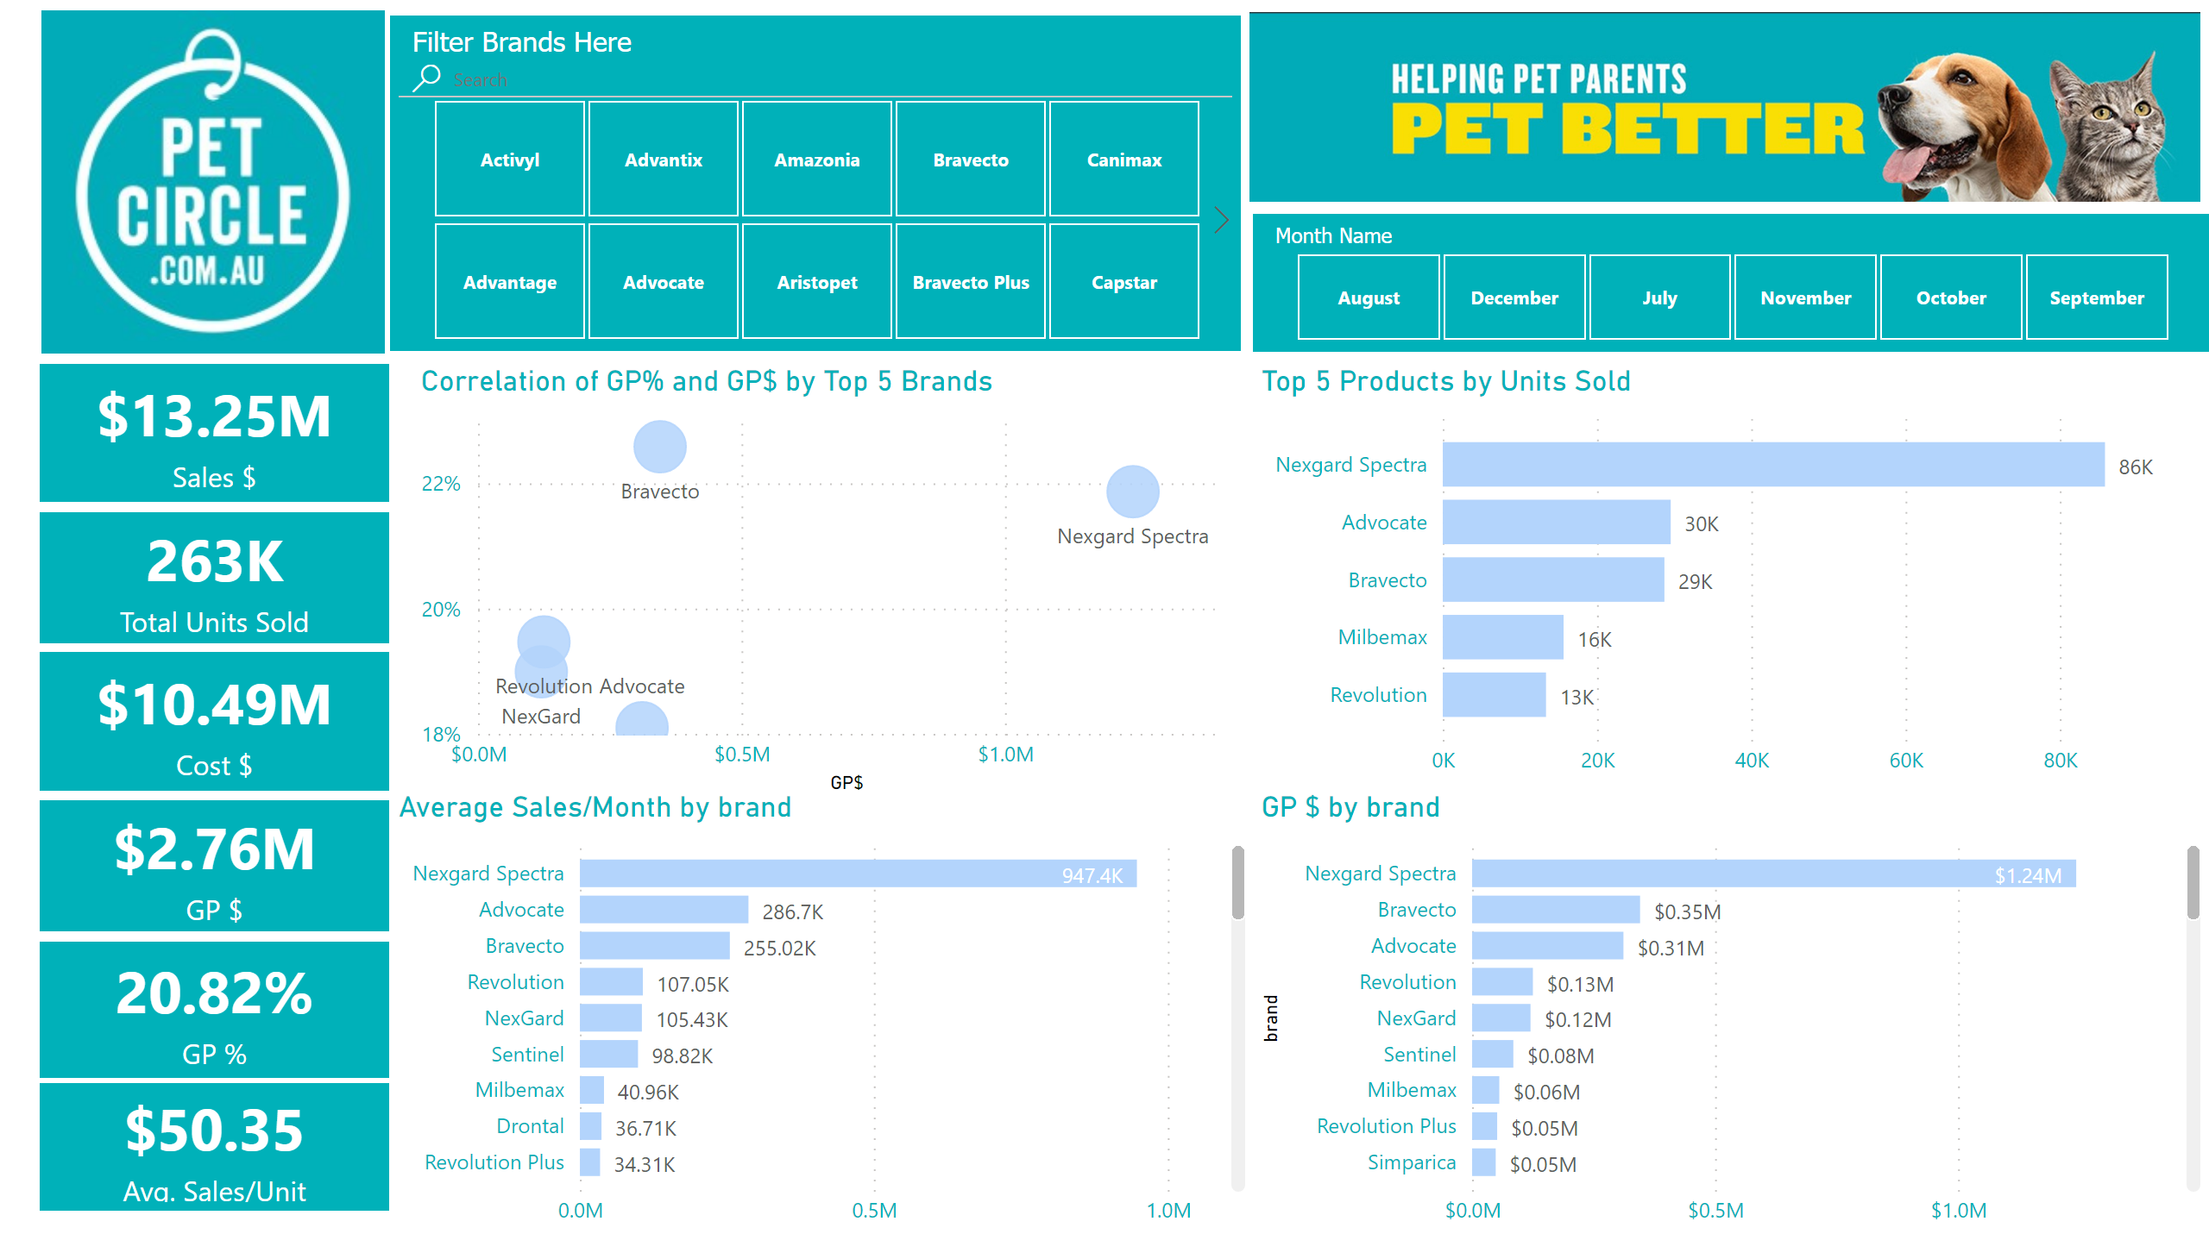
Best Brands Performance
Notes:
image
No alt text provided
image
No alt text provided
card
No alt text provided
card
No alt text provided
card
No alt text provided
card
No alt text provided
card
No alt text provided
card
No alt text provided
slicer
No alt text provided
slicer
No alt text provided
Correlation of GP% and GP$ by Top 5 Brands
No alt text provided
Top 5 Products by Units Sold
No alt text provided
GP $ by brand
No alt text provided
clusteredBarChart
No alt text provided

Slide 4
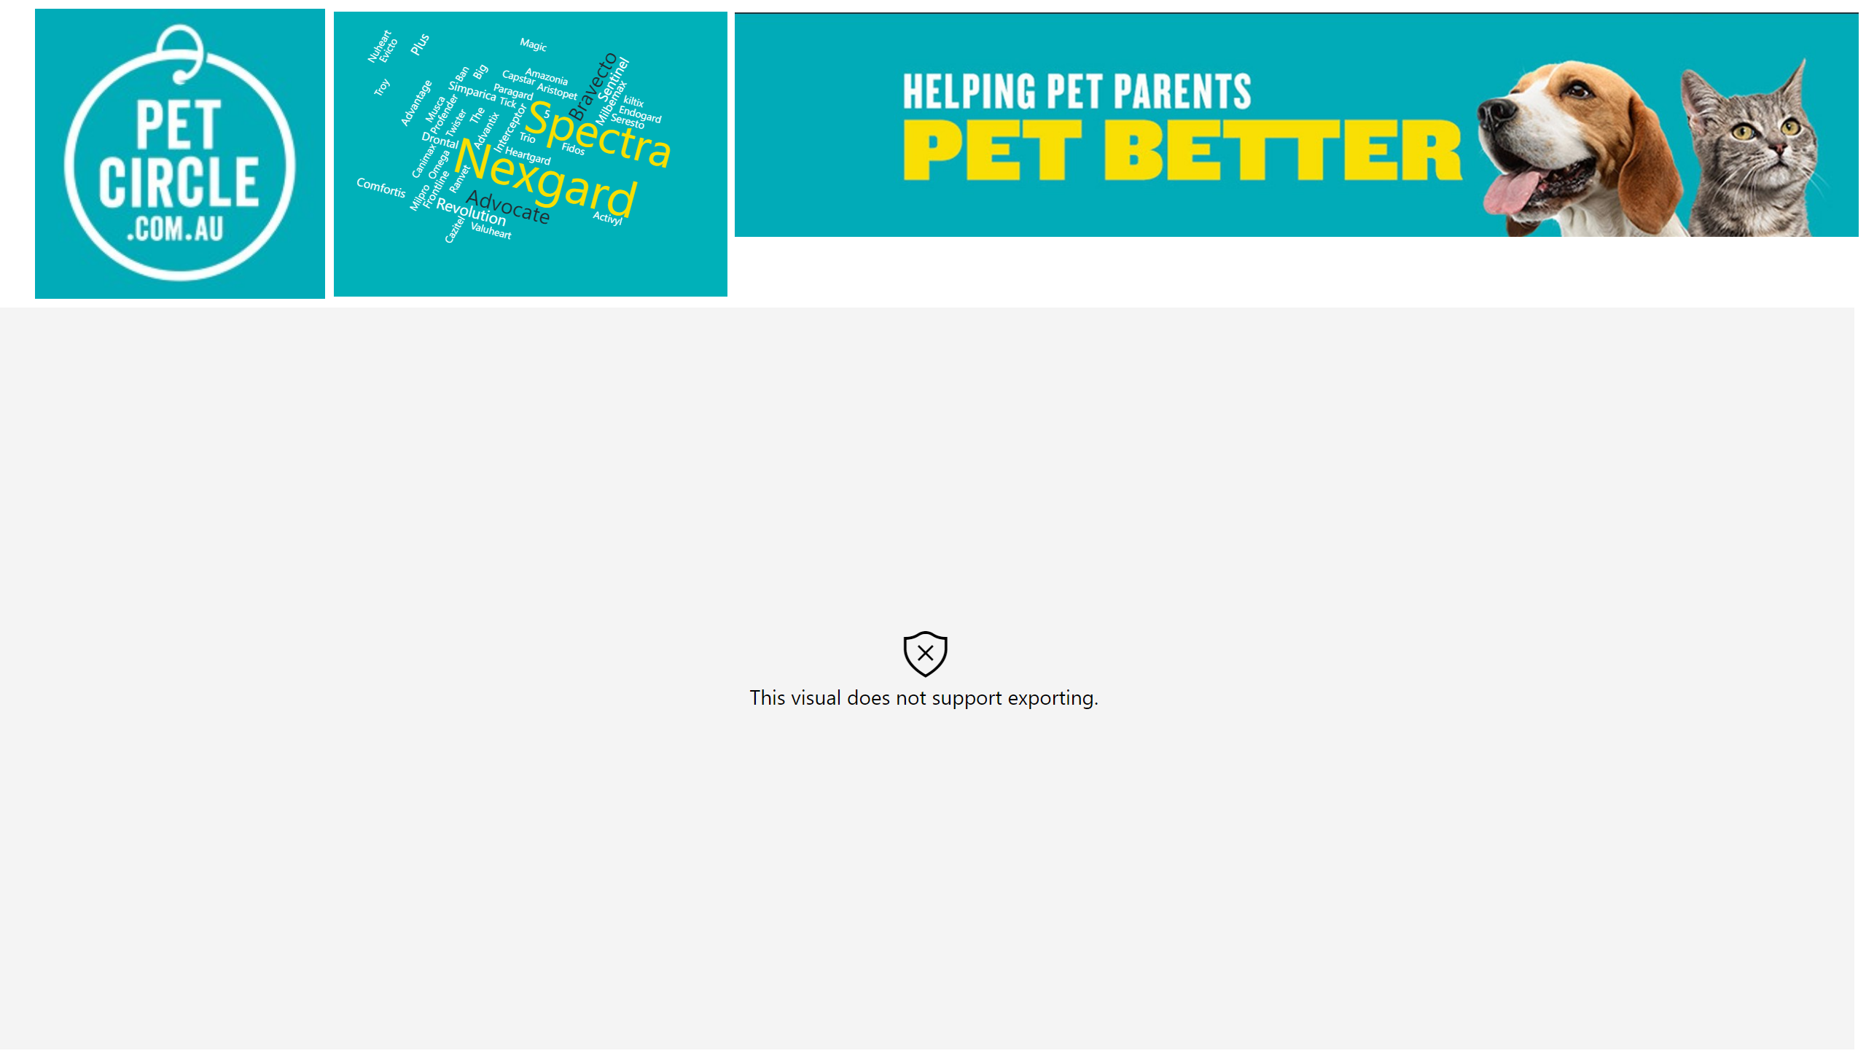
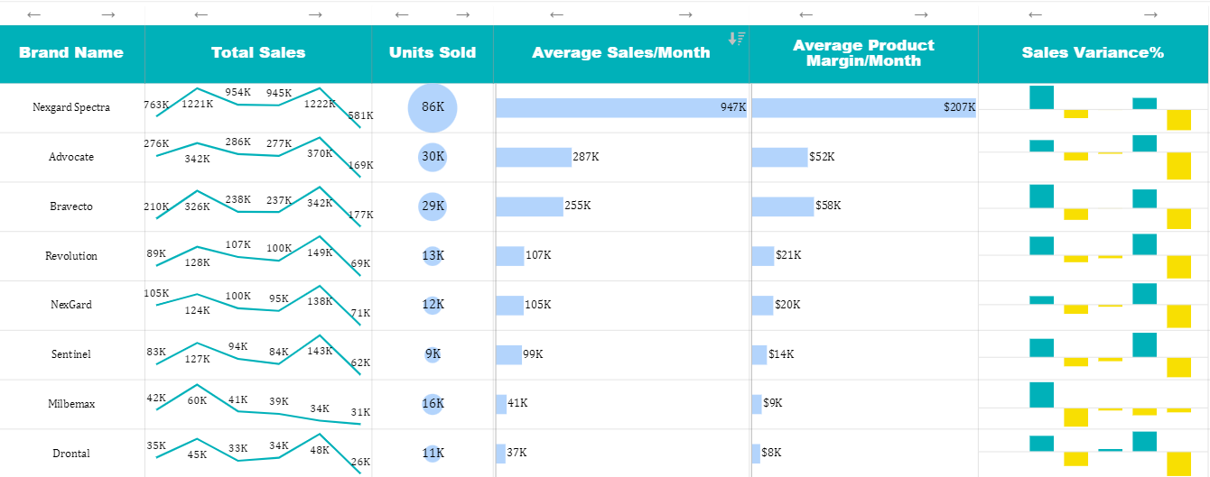
All Brands Comparison
Notes:
sparklines50DB3783432B40A69C0B91926CE74CD9
No alt text provided
WordCloud1447959067750
No alt text provided
image
No alt text provided
image
No alt text provided
Word Clouds of Brand by Sales
No alt text provided

Slide 5
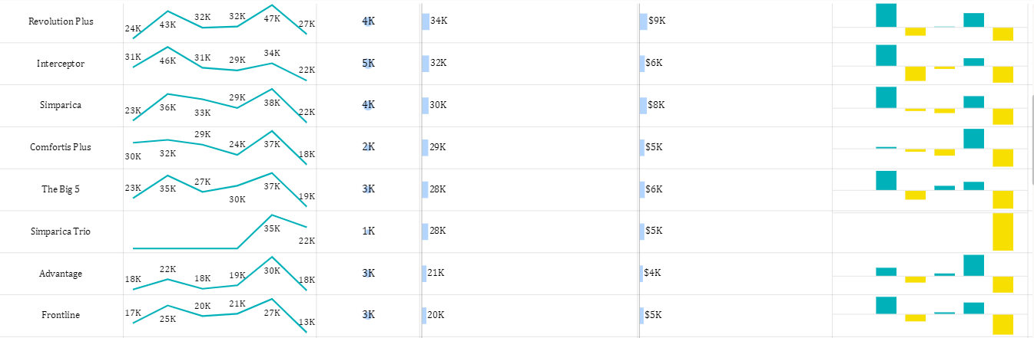
All Brands Comparison
Notes:
sparklines50DB3783432B40A69C0B91926CE74CD9
No alt text provided
WordCloud1447959067750
No alt text provided
image
No alt text provided
image
No alt text provided
Word Clouds of Brand by Sales
No alt text provided

Slide 6
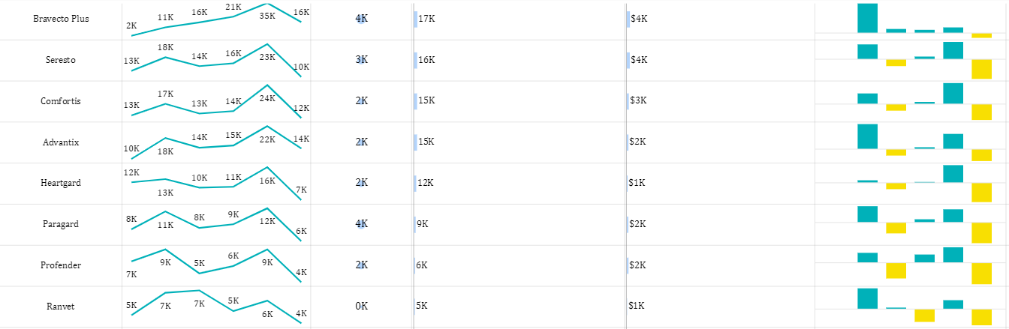
All Brands Comparison
Notes:
sparklines50DB3783432B40A69C0B91926CE74CD9
No alt text provided
WordCloud1447959067750
No alt text provided
image
No alt text provided
image
No alt text provided
Word Clouds of Brand by Sales
No alt text provided

Slide 7
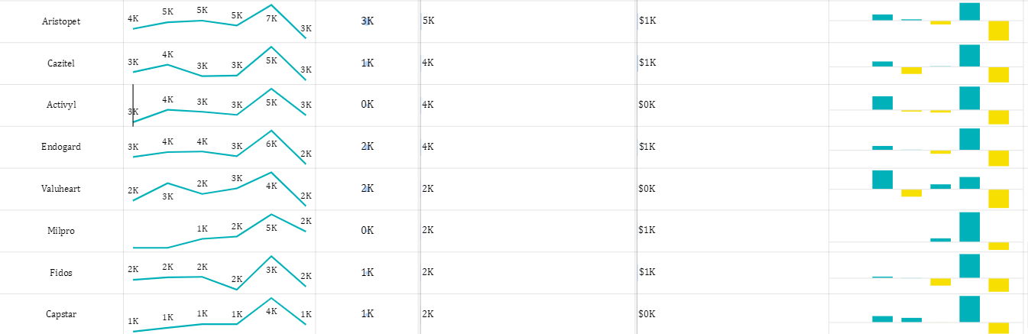
All Brands Comparison
Notes:
sparklines50DB3783432B40A69C0B91926CE74CD9
No alt text provided
WordCloud1447959067750
No alt text provided
image
No alt text provided
image
No alt text provided
Word Clouds of Brand by Sales
No alt text provided

Slide 8
All Brands Comparison
Notes:
sparklines50DB3783432B40A69C0B91926CE74CD9
No alt text provided
WordCloud1447959067750
No alt text provided
image
No alt text provided
image
No alt text provided
Word Clouds of Brand by Sales
No alt text provided

Slide 9
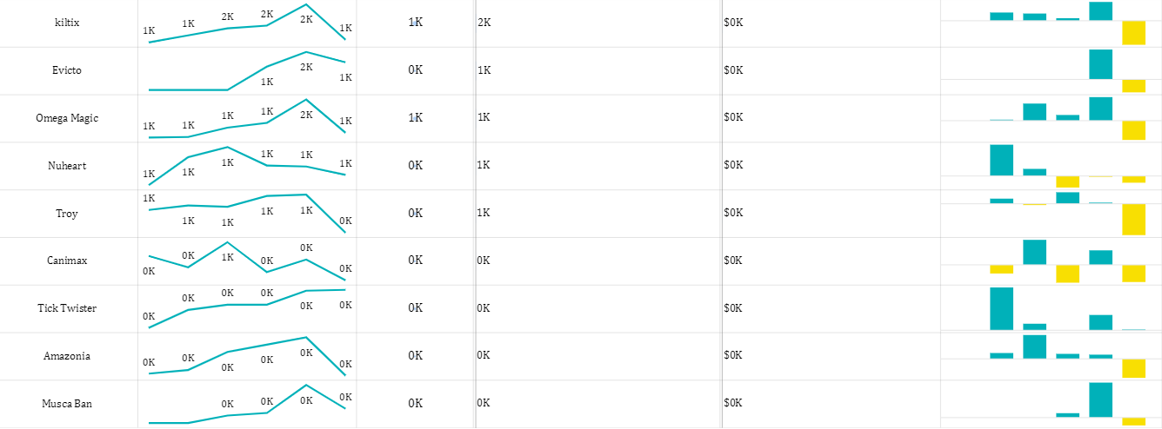
All Brands Comparison
Notes:
sparklines50DB3783432B40A69C0B91926CE74CD9
No alt text provided
WordCloud1447959067750
No alt text provided
image
No alt text provided
image
No alt text provided
Word Clouds of Brand by Sales
No alt text provided

